Slide 1
ERD Practice

Slide 2
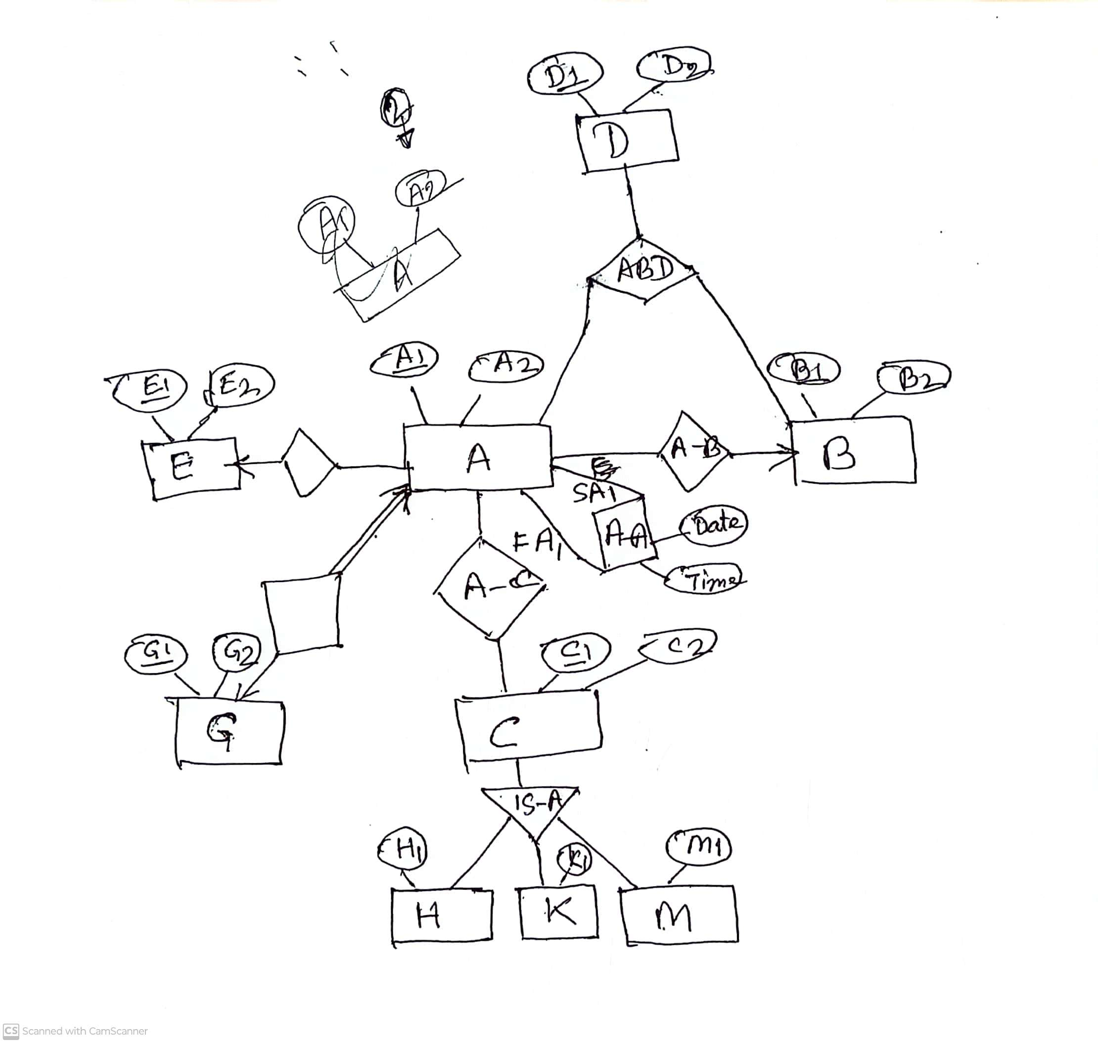
A-E
A-G

Slide 3
Relation Schemas
A (A1, A2, B1, E1, G1)
B (B1, B2)
D(D1, D2)
E (E1, E2)
G (G1, G2)
A-B X
ABD(A1, B1,D1)
A-E X
A-G X
A-C (A1, C1)
A-A (SA1, FA1, date, time)
C (C1, C2)
H (C1, H1)
K (C1, K1)
M(C1, M1)

Slide 4
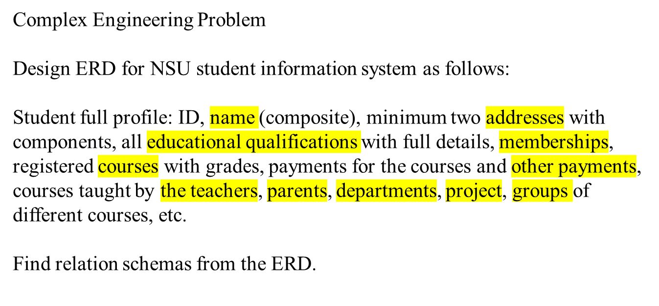

Slide 5
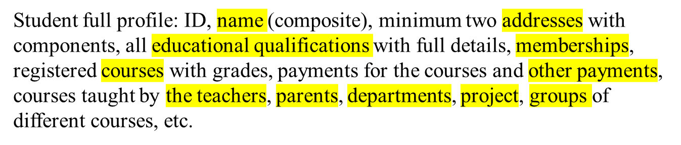
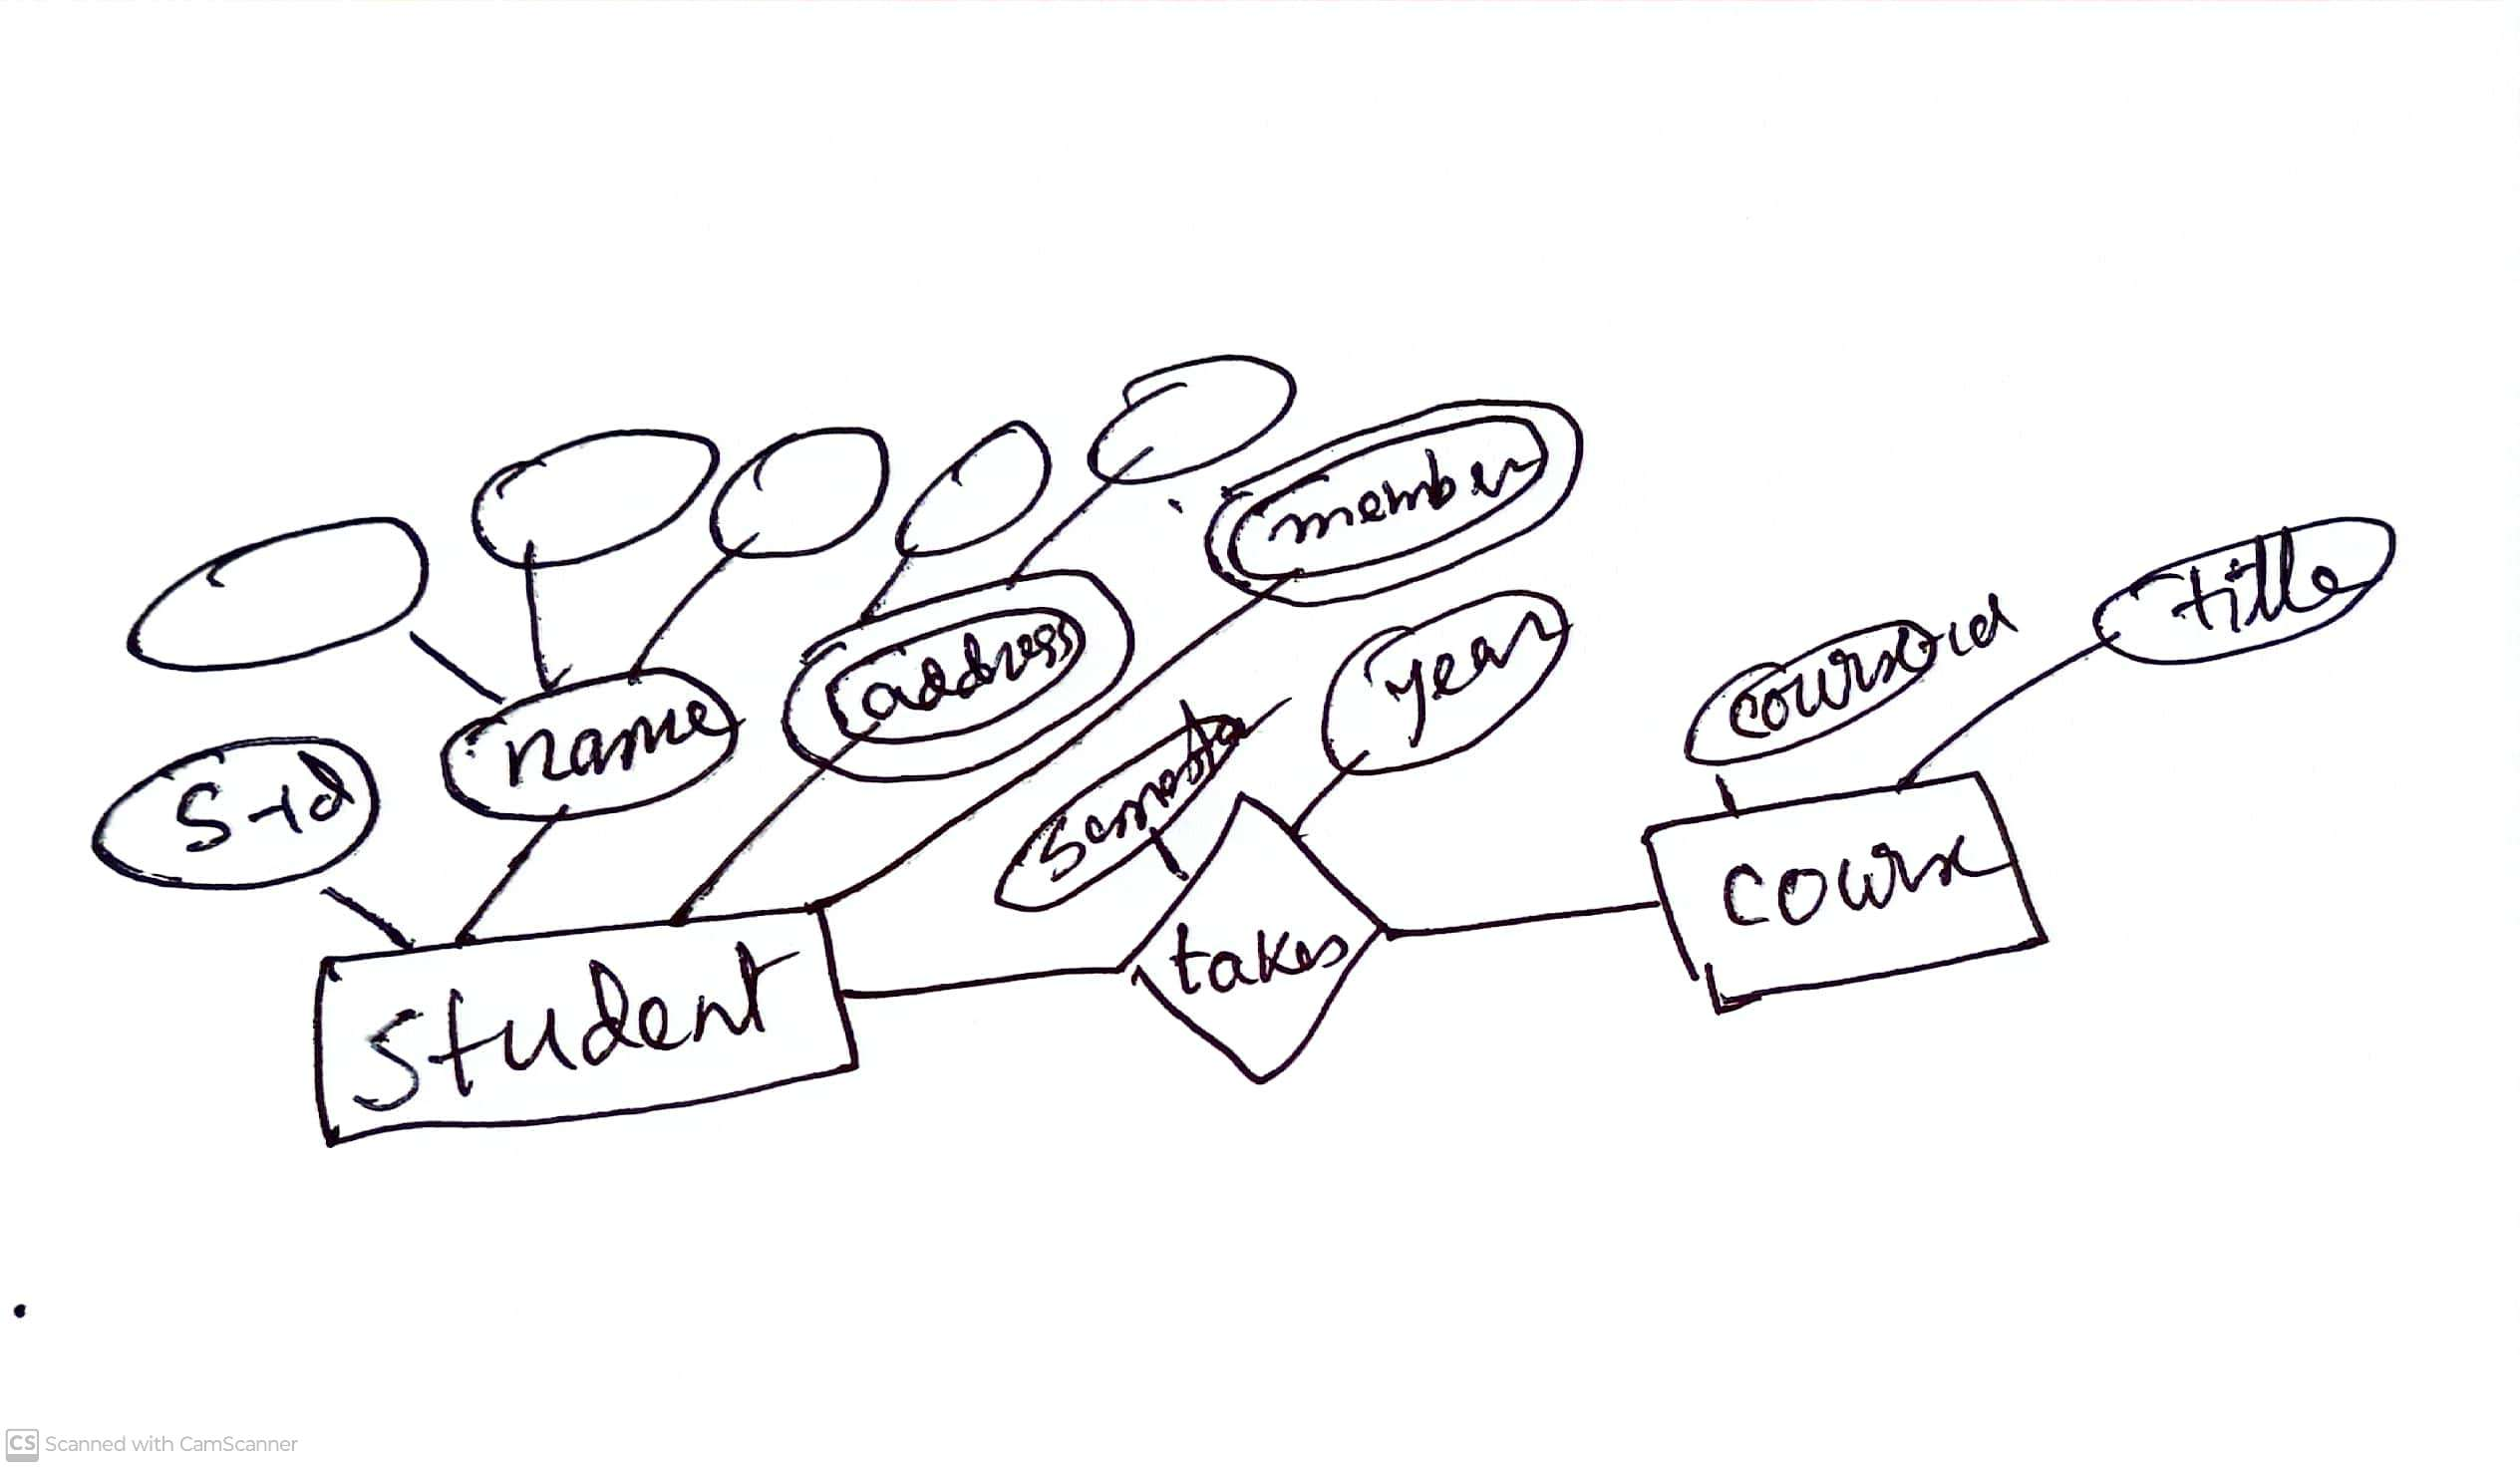

Slide 6
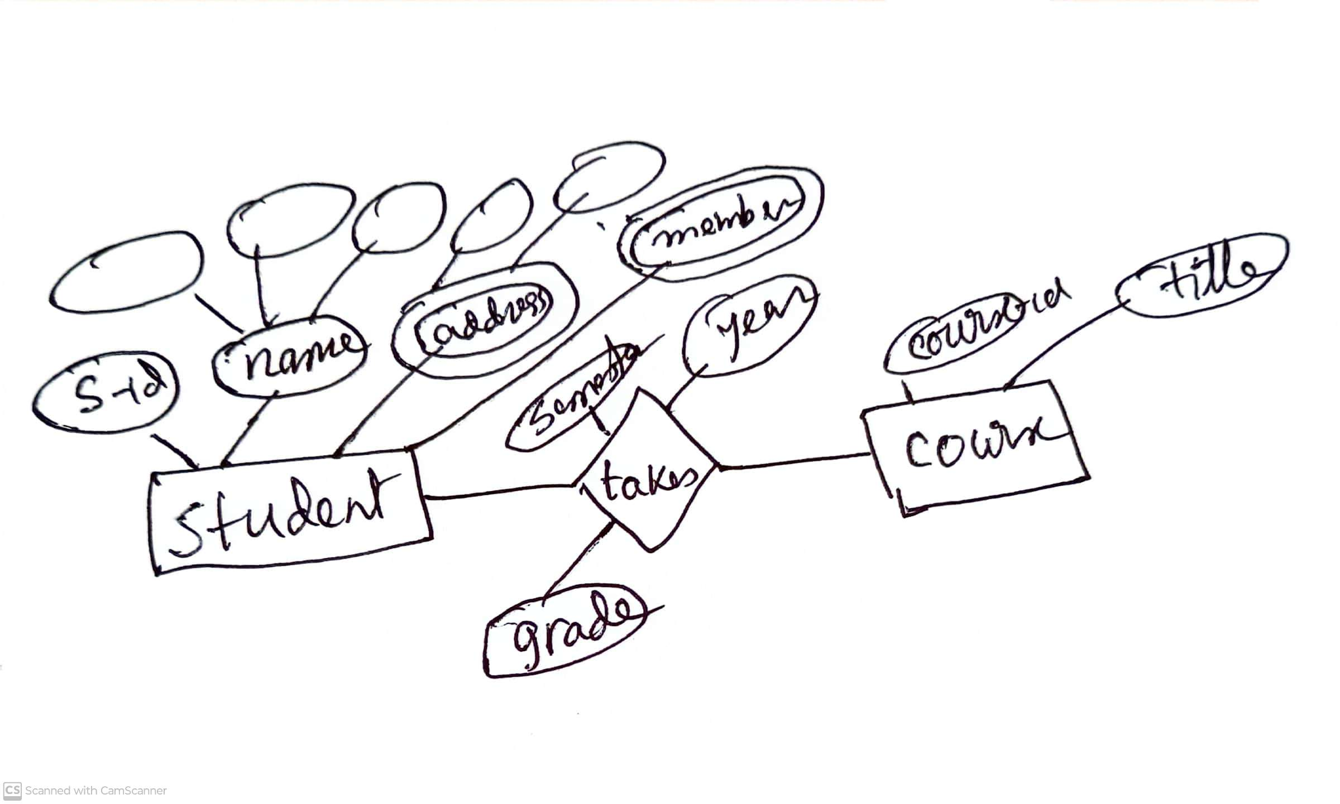

Slide 7
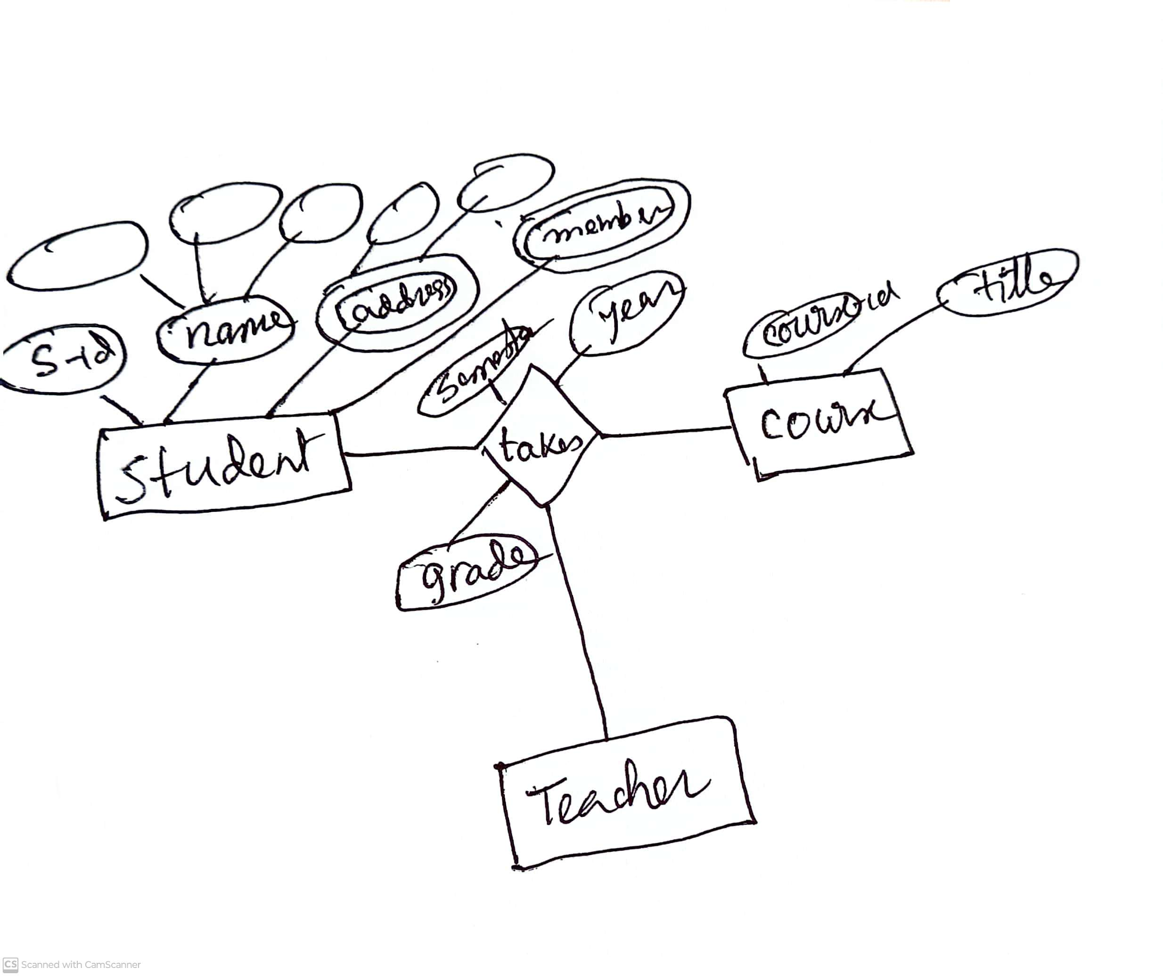

Slide 8
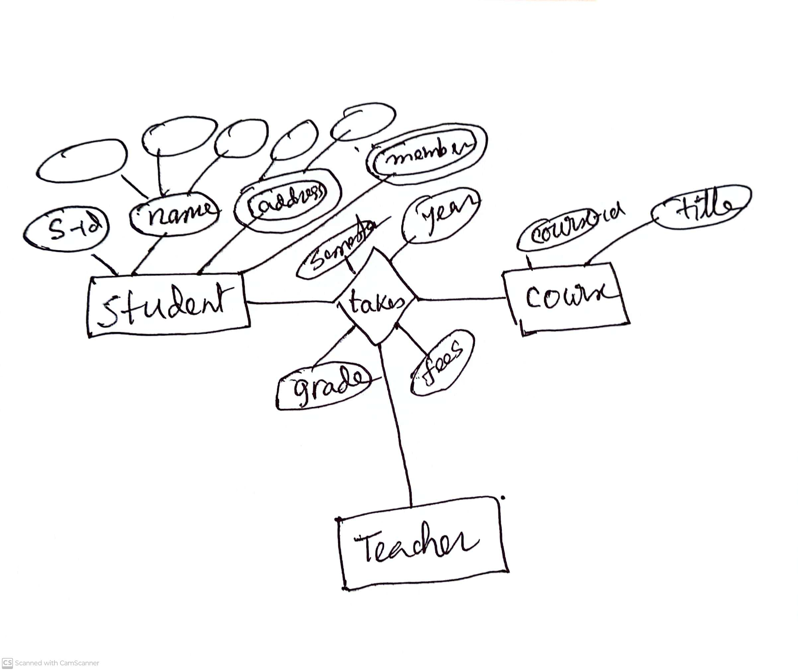

Slide 9
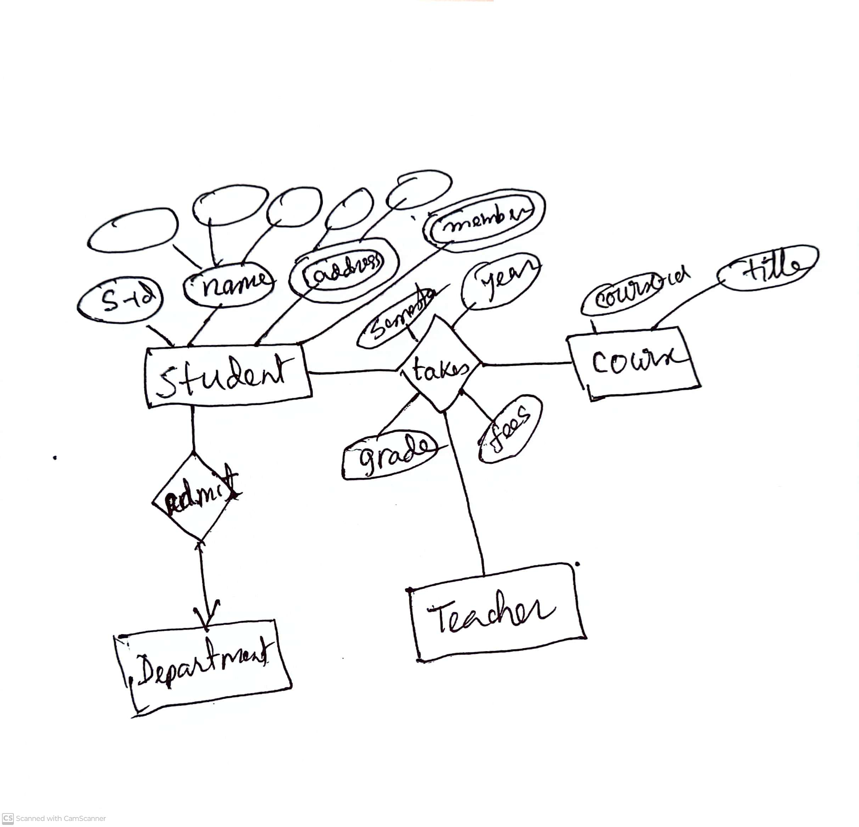

Slide 10
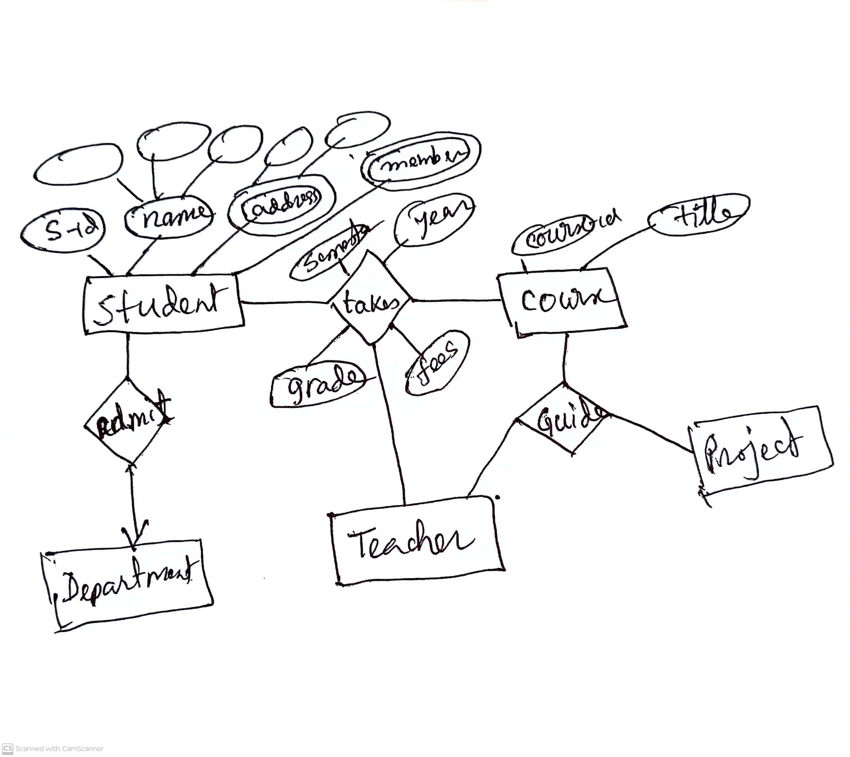

Slide 11
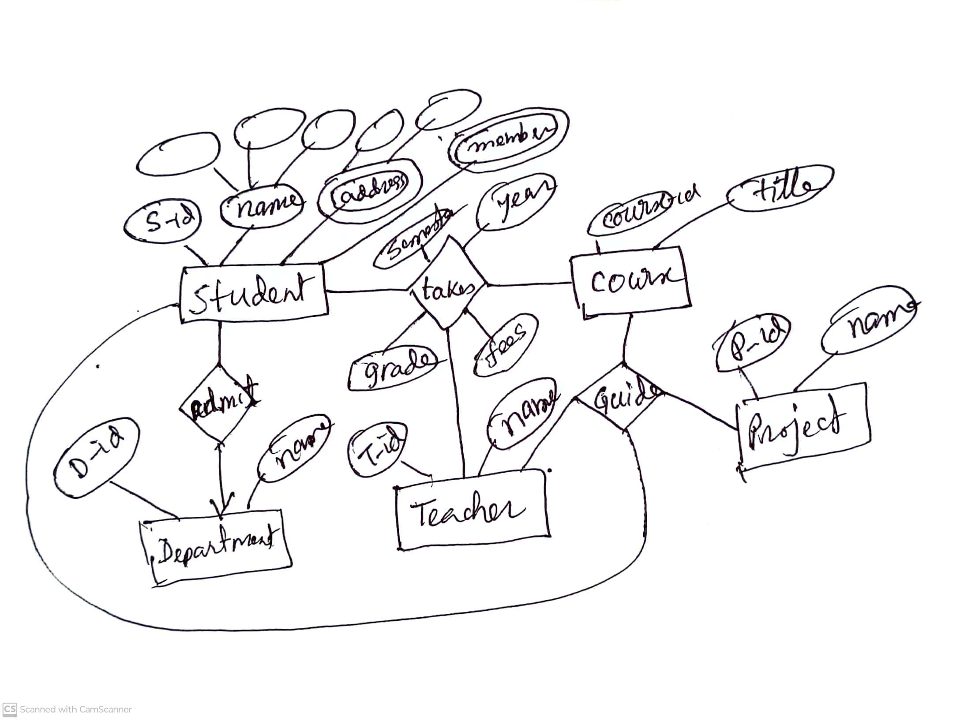
Finally reduction to schema!!

